Slide 1
REAL-TIME POINT CLOUD CONSTRUCTION AND INFORMATION SYSTEM
RESEARCH GROUP OF AMBIENT INTELLIGENCE
Notes:
Start Willem

Slide 2

Contents
Members and roles
Planning
Project Description
Research questions
Results
Problems
Demonstration
Recommandations

Slide 3
Members and roles
Current:
Willem Lefferts - ROS/Unity development - HBO-ICT
Andrei ‘Jesse’ Martashov - ROS/Unity development - CMGT
Stan Smeitink - Unity development - HBO-ICT
David Heetebrij - Unity development - CMGT
Former:
Joost Kolkman - HBO-ICT
Notes:
Joost en Stan hebben VR headset van school.
David heeft een eigen VR en werkt meer aan de interface.

Slide 4
Planning
Weekly meetings with tutor/client
Short-term planning
Planning based on results

Slide 5
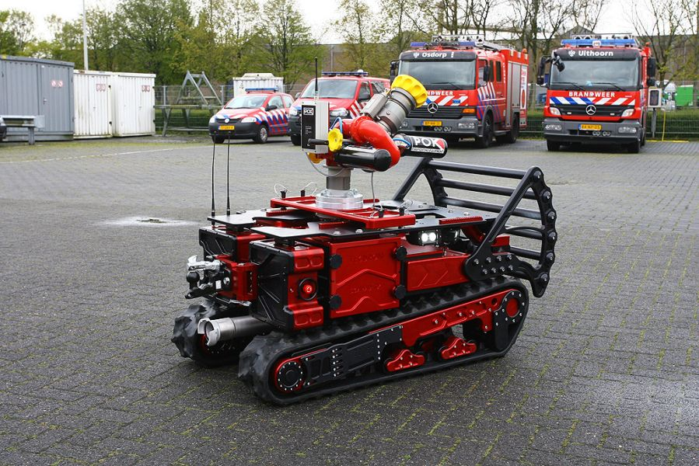
Project Description
Displaying a point-cloud map streamed from a firefighter scout robot in VR
Researching or implementing a good VR interface to improve the experience of using the robot

Slide 6
Research Questions
What does the fire department want to use “The Scarab” for?
Scouting and mapping hazardous buildings
Controlling and showcasing the 3D map of the environment
Gather more information about hard to reach buildings

Slide 7
Research Questions
How can we implement a point cloud in VR with Unity?
Unity ROS# plugin to stream point-cloud data from ROS to Unity
Unity XR plugin to use VR view and controls
What optimizations are going to be needed?

Slide 8
Research Questions
How to visualize data from ROS to Unity?
How can we get point cloud data from the raw data?
How can we get the data from ROS to Unity?
How can we show the point cloud in Unity?

Slide 9
Results - Connecting Unity and ROS
ROSbridge establishes a connection
Stereo image processing
ROS publishes to ROSbridge
Unity subscribes to data
Unity renders point cloud

Slide 10
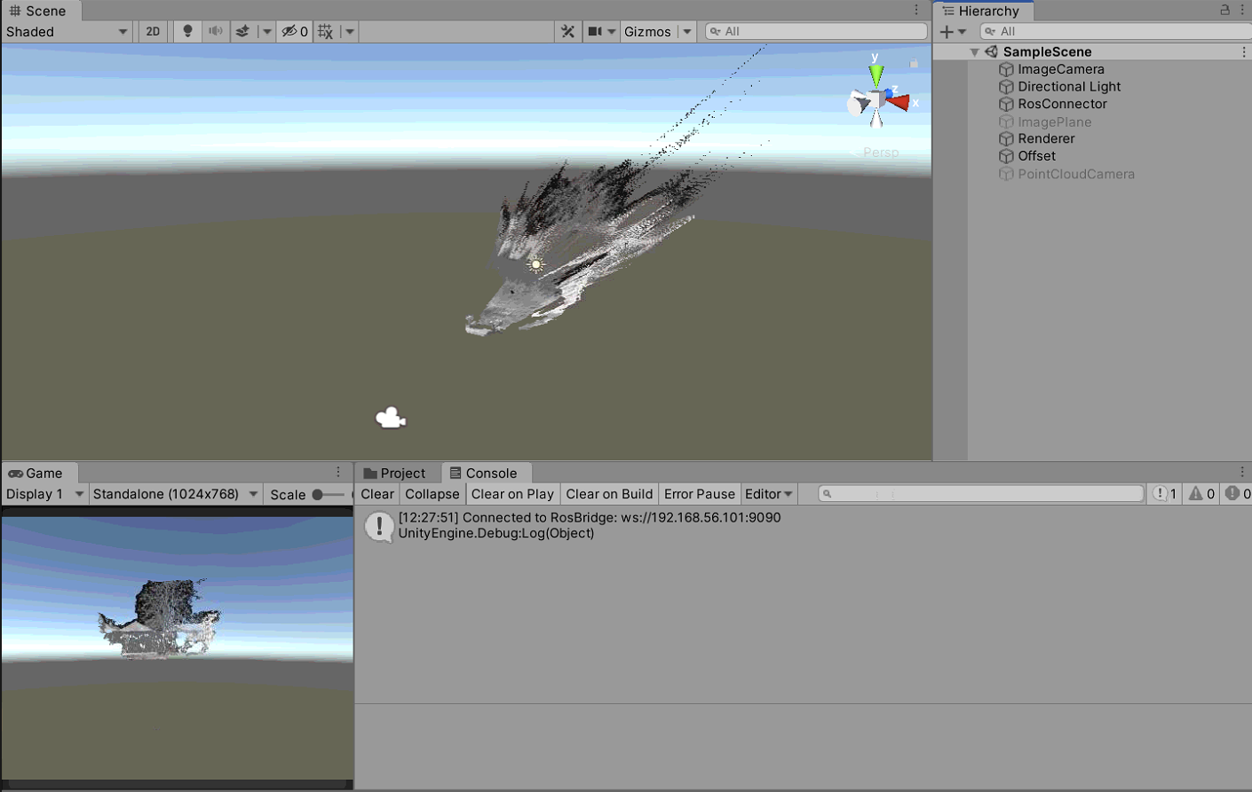

Slide 11
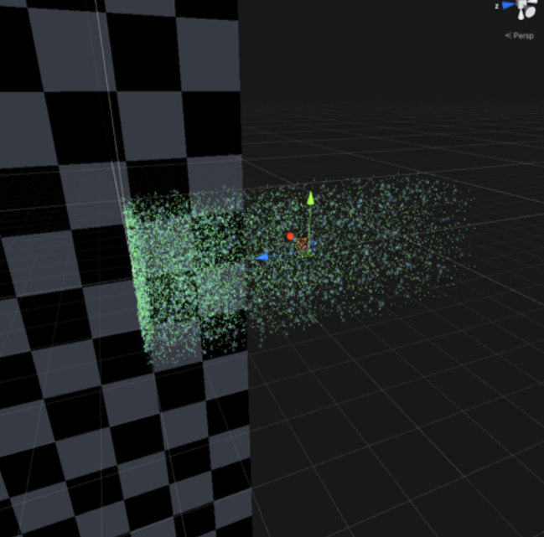
Results - Distance optimization
Separate Distance optimization prototype
Tests point culling method - the further away the points are from the camera, the more points are going to be removed
Notes:
End Willem -> Start Jesse

Slide 12
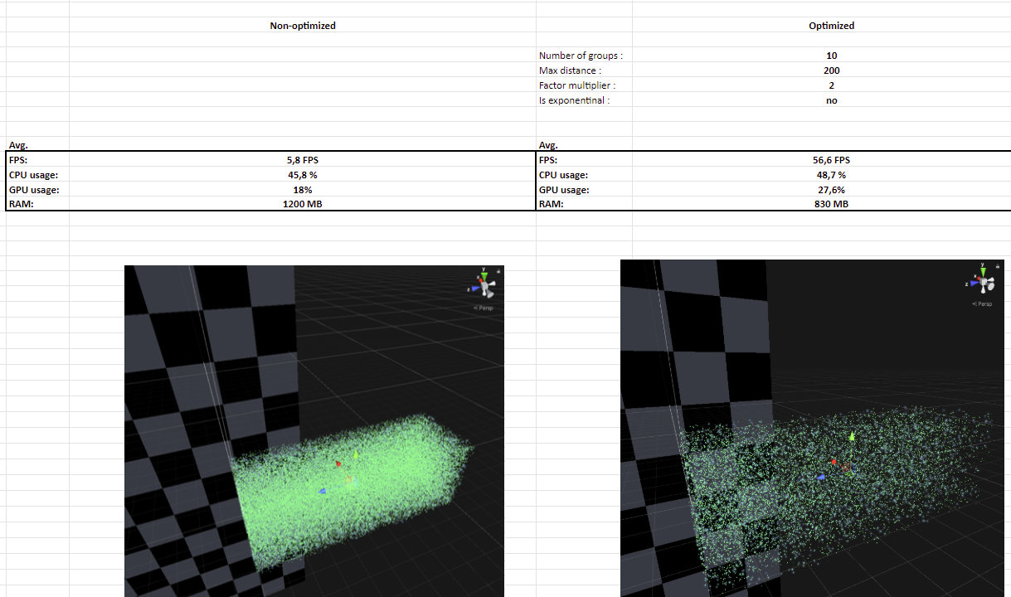
Results - Distance optimization
Documented test results
Parameters comparison
Notes:
End Willem -> Start Jesse

Slide 13
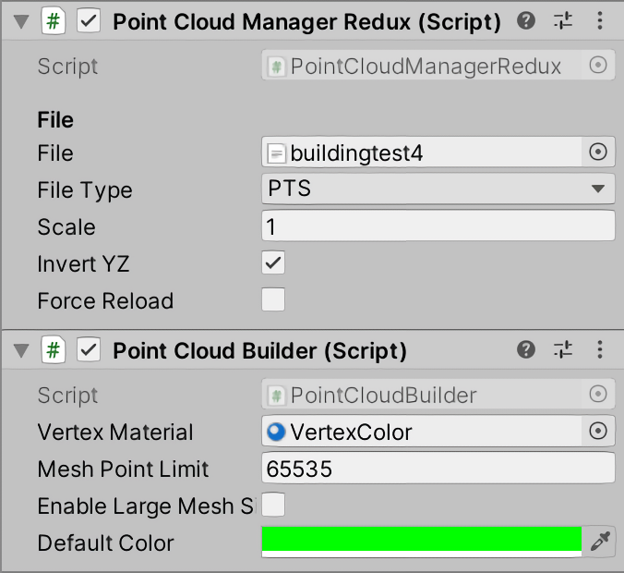
Results - Mesh optimization
Separate mesh optimization prototype
Two scripts adapted from a free unity plugin
Points are separated into groups, which are then turned into meshes

Slide 14
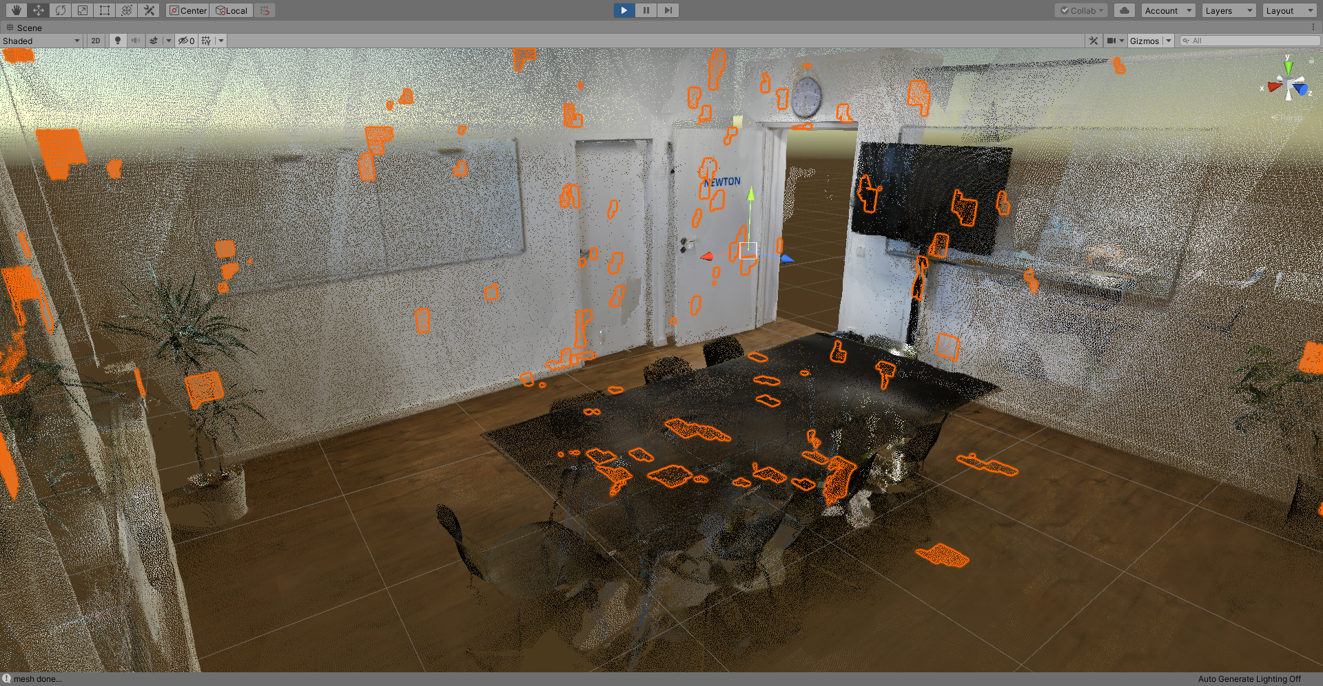
Results - Mesh optimization

Slide 15
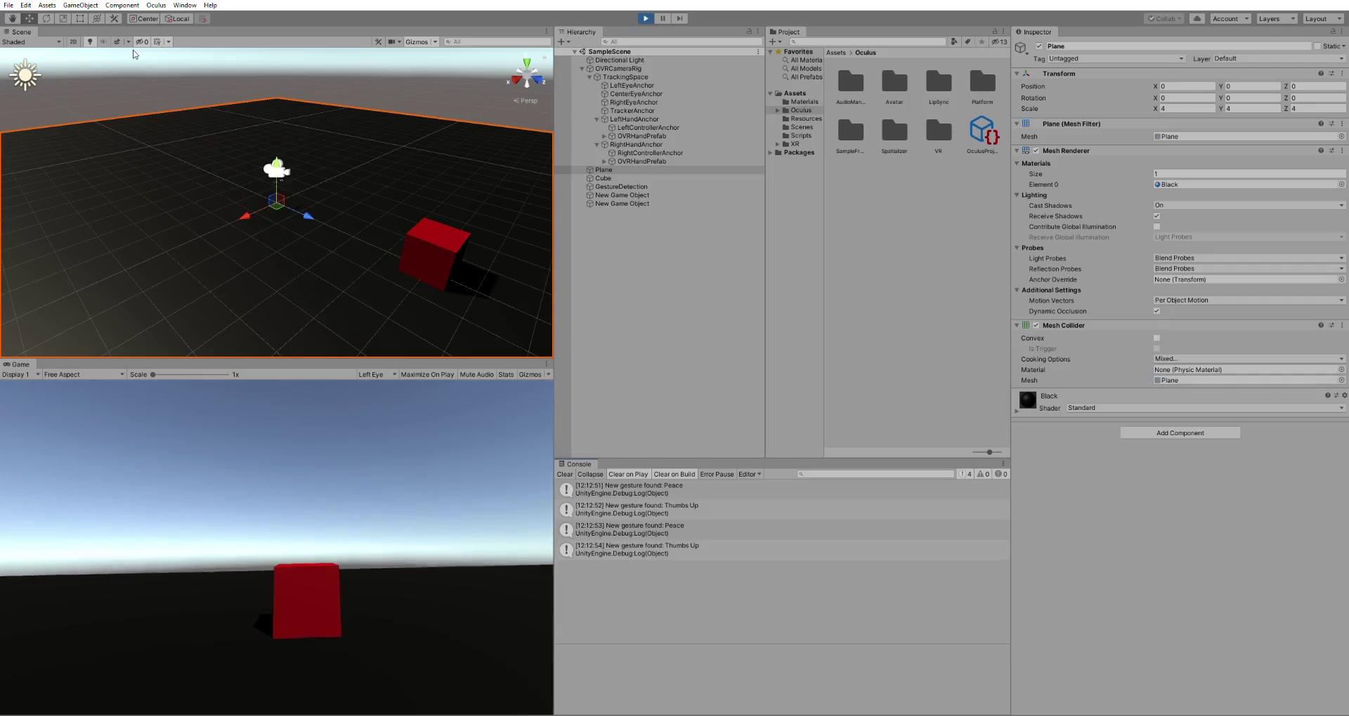
Results - Unity VR Integration
PointCloud2 data (ROS#)
Converting bytes to floats
Gesture Control
Oculus Link
Notes:
End Jesse -> Start Stan

Slide 16
Problems
Application receives data very slowly
CPU is capping the FPS, not GPU → not a rendering problem
Turning the byte array into a point cloud does not take a long time → not a processing error
JavaScript receives data faster than Unity
Serializer makes a difference in speed:
Microsoft serializer → VR application subscribes, receives data very slow
JSON serializer → VR application does not subscribe, PC does, receives data quicker

Slide 17
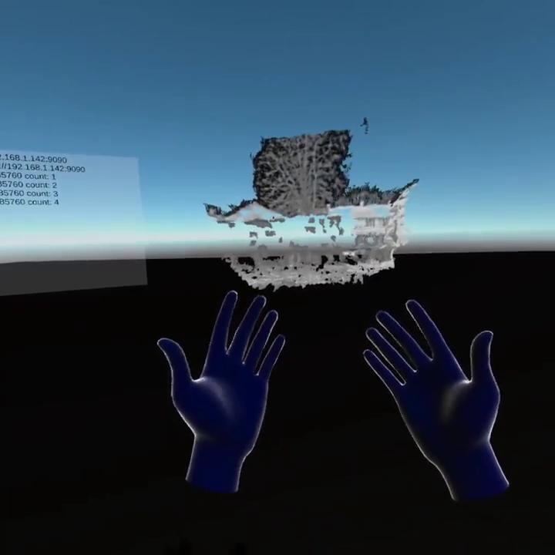
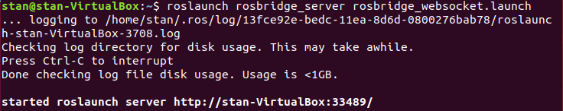
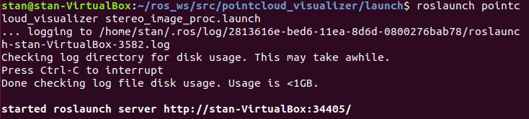
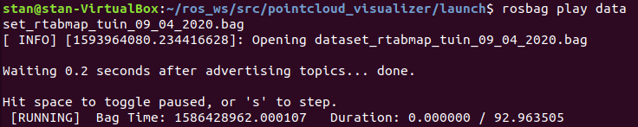
Demonstration

Slide 18
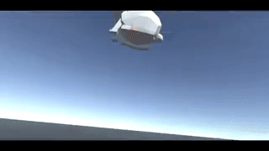
Recommandations
Improve the loading time of the data from ROS
Understanding PointCloud2 data
Prototype User Interface
Figure out motion sickness problem
Hand Gestures
Use Vulkan instead of OpenGL
Longer distance connection
Use a 360 camera for more detailed Point Cloud data

Slide 19
Questions?
Thanks for your attention!

